Slide 1
Banking Application Capstone Presentation
Radwa Aboudina

Slide 2
Part 1: Front-End Architecture, Authentication, And App Diagram

Slide 3
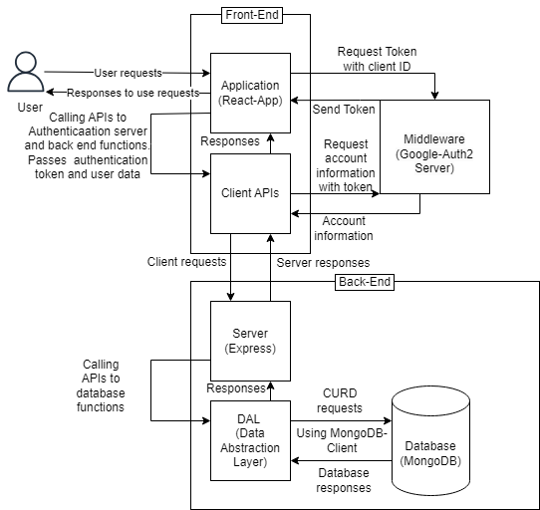
Application Overview Diagram

Slide 4
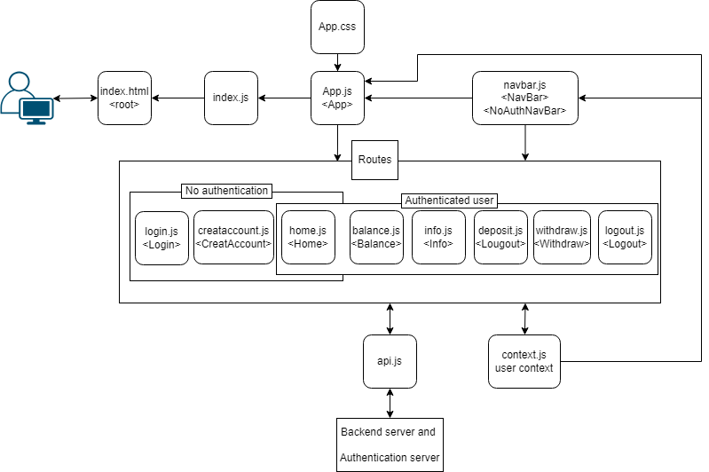
Front-End Architecture – Component Architecture Diagram

Slide 5
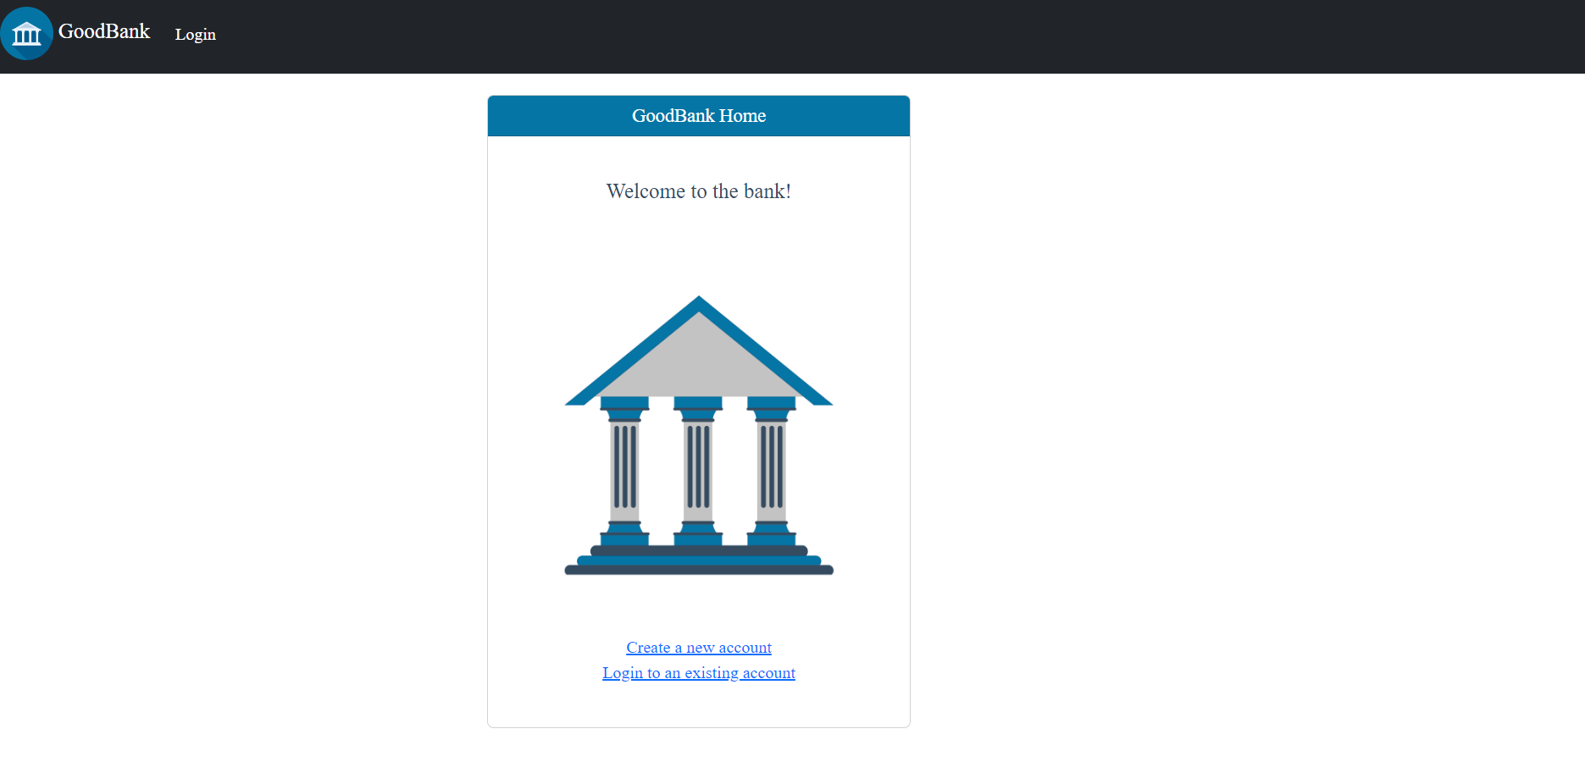
Front-End Architecture – UI Design Decisions
Styling using react bootstrap
All pages and forms are displayed in react bootstrap card components

Slide 6

Front-End Architecture – UI Design Decisions
The navigation bar shows the functions available to the user based on the user authentication status.

Slide 7
Front-End Architecture – UI Design Decisions
The basic functions are available in the navigation bar and there are also links in every page that lead to the user possible next required functions.

Slide 8
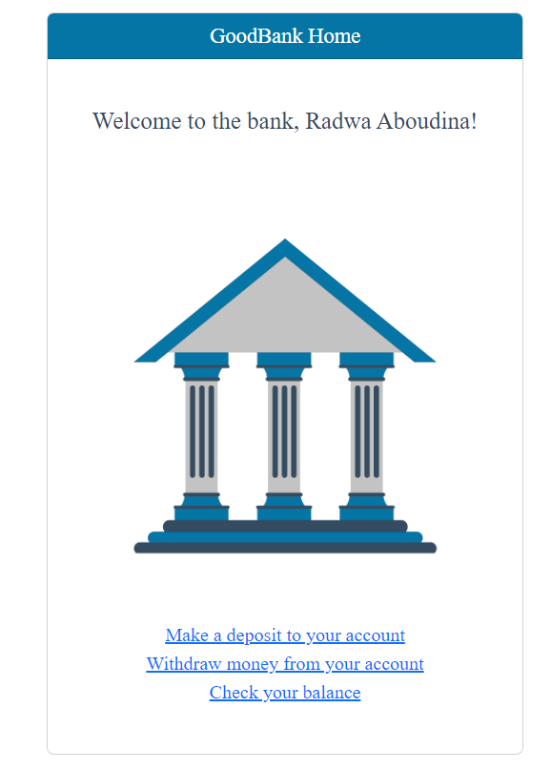
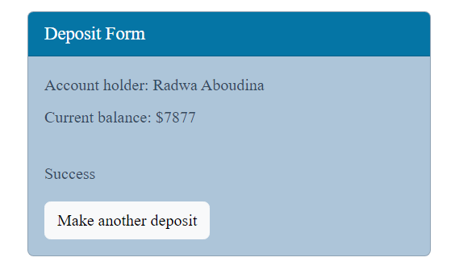
Front-End Architecture – UI Design Decisions
Success messages or welcome messages are displayed to the user with every response to a user request.

Slide 9
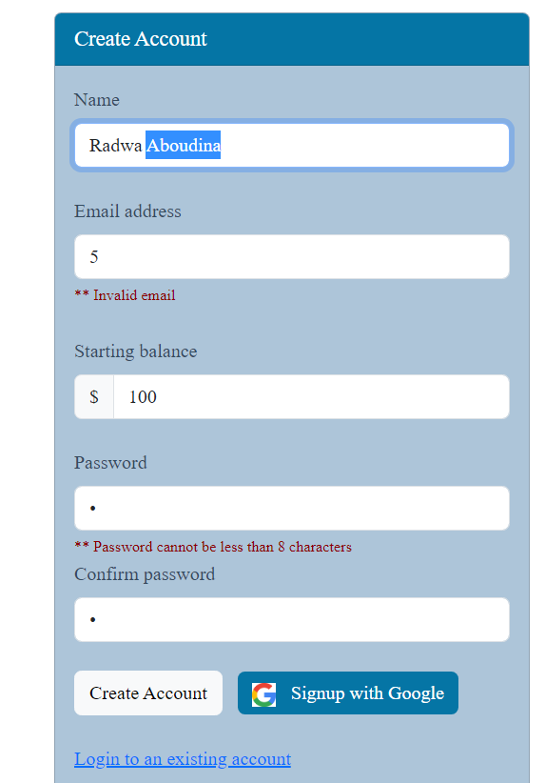
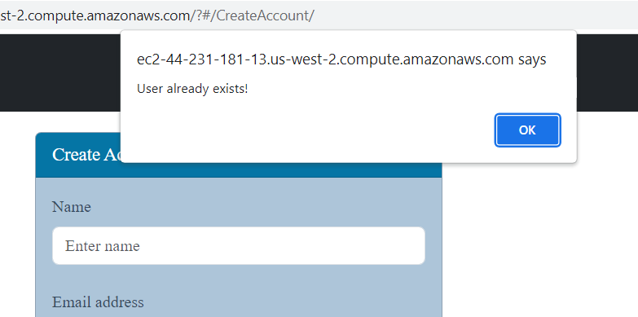
Front-End Architecture – UI Design Decisions
Errors are displayed to the users in the form of alert windows and error messages under invalid fields.

Slide 10
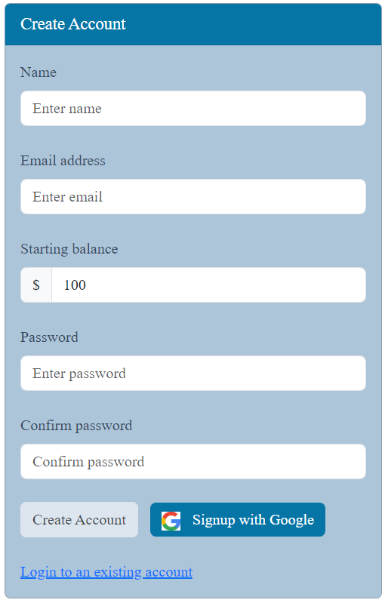
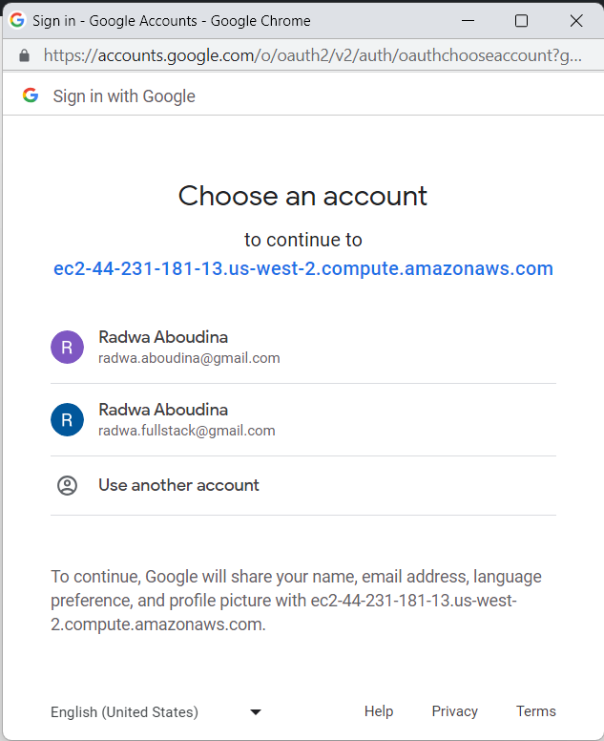
Authentication – Signing up
Methods of Authentication
Email and password
Google OAuth

Slide 11
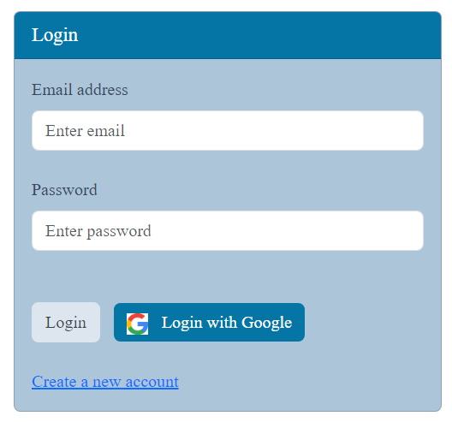
Authentication – Loging in
Methods of Authentication
User name and password
Google OAuth

Slide 12
Authentication – Challenges & Solutions
Challenge: At first I ran the database on docker.
No access outside of local machine, after website was deployed.
Had to keep docker desktop running.
Solution: I ran the database on MongoDB Atlas which provided me with a URL that is always running and I could use anywhere

Slide 13
Authentication – Challenges & Solutions
Challenge: At first I ran the database on docker.
No access outside of local machine, after website was deployed.
Had to keep docker desktop running.
Challenge: The Google authentication server kept denying my access requests.
Solution: I ran the database on MongoDB Atlas which provided me with a URL that is always running and I could use anywhere
Solution: Found out I needed authorize my local server URL on Google API manager, by adding it to the list of authorized URLs in my Client ID console. I also added my deployed website URL.

Slide 14
Part 2: Database And API

Slide 15





Database - Overview
Type: MongoDB, non-relational document based.
Hosted on MongoDB Atlas
Can be connected to and viewed using tools like
MongoDB Compass
Studio 3T
Robot 3t.

Slide 16
Database - GoodBank
MongoDB database
“goodbank”
Database: goodbank
Collection: users
Document fields:
ID
Name
Email
Password
Balance
Collection
“users”
Fields
Document
ID
Name
Email
Password
Balance
Document
……
Document

Slide 17
Database - DAL
The DAL (Data Abstraction Layer):
Is a layer between the server and the database that provides API functions needed to perform the different functionalities needed by the server to or from the database.
Communicates directly with the database to create, update, read, or delete using the database API.

Slide 18
Database - DAL
Example: Create Account
Back-End
Calls API function “find”
Receives documents from database and returns it to server
Calls API endpoint “insertOne” to add new user
Receives newly created user document and returns it to server
Validates inputs and calls API function to send http request to server.
Calls API from DAL to find documents with the same email
If any are returned, sends back response to user with a failure message “User already exists”
If none are returned calls API from DAL to add a new user document with requested data.
Receives the newly added document details from DAL and sends it back to Client with a success message.
DAL
Client
Server
Database
Request:
Create
Account
Inputs:
-Name
-Email
-Password
-Password
confirmation
-Starting
balance
http request:
Create
Account
Parameters:
-Name
-Email
-Password
-Balance
Calls API:
Find
Arguments:
-Email
Calls API:
find
Arguments:
-email
User
Returns:
Documents with matching email
Returns:
Documents with matching email
http response:
User data and success/failure messages
Calls API:
insertOne
Arguments:
-User data
Calls API:
Create
Arguments:
-User data
Response:
Welcome message or failure alert
Returns:
-Newly created user document
Returns:
-Newly created user document

Slide 19
Database – Added Feature
Delete account
Added an API endpoint that takes an email an password and deletes the corresponding user account form the database.
Added a function in the DAL than can access the database and delete a document form the user collection with a document id.
Password encryption for extra security
Using the “bcrypt” encryption library
Upon receiving the client request to create an account the password is encrypted and saved in the database in the encrypted form.
When a login request is received from the client the “bcrypt.compare” function is used to compare the two passwords.

Slide 20
API – RESTful or GraphQL?
Did I use Restful or GraphQL?
No, it was needed. The database in this application is pretty small, there are very few fields in the users collection. There wasn’t a case when only a subset of the document fields was needed. Hence, no special interface or query languages like RESTful or GraphQL were necessary.
What I used:
Client to server: simple http requests using the Axios library
Server to database: the low-level communication MongoClient library

Slide 21
API – Endpoints description
Routes to be called by the client, provided by the server to be called using axios http requests with the server URL
create
// create user account
app.get("/create/:name/:email/:password/:balance",…)
login
// login user
app.get("/login/:email/:password",…)
update
// update - deposit/withdraw amount
app.get("/update/:email/:amount",…)
delete
// delete user account
app.get("/users/:email/:password",…)

Slide 22
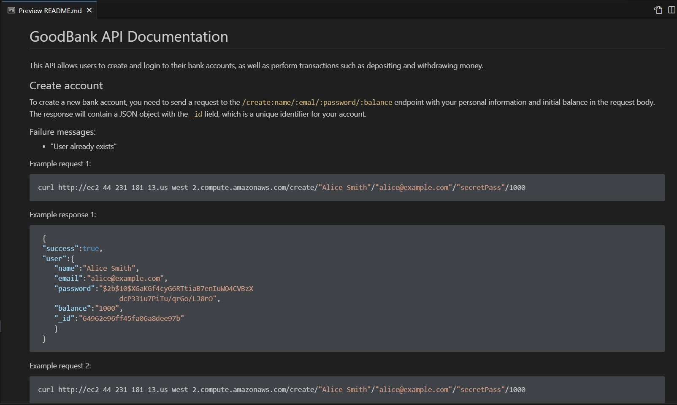
API – Endpoints documentation

Slide 23
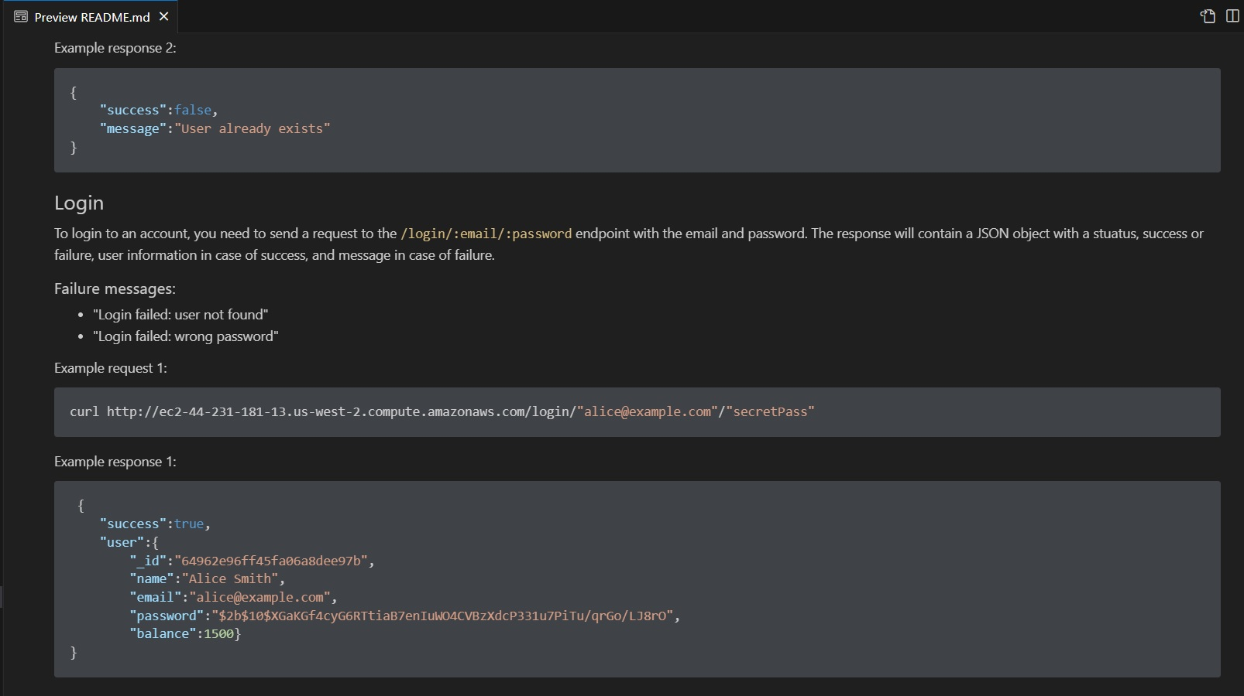
API – Endpoints documentation

Slide 24
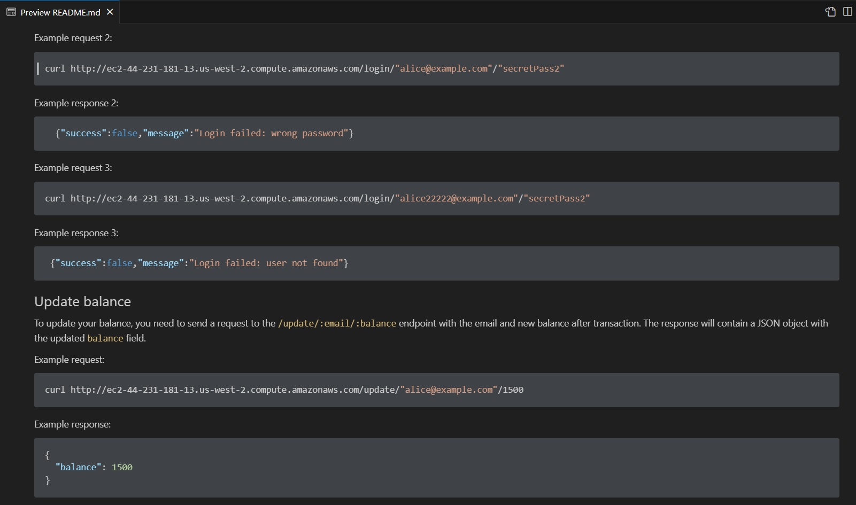
API – Endpoints documentation

Slide 25
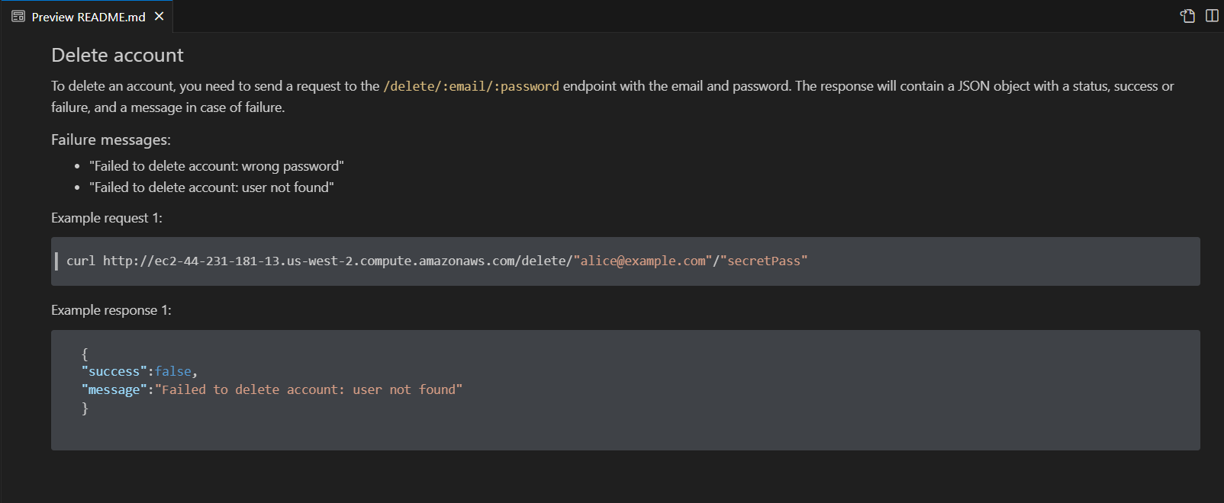
API – Endpoints documentation

Slide 26
Part 3: Deployment, Additional Features, App Demonstration, Reflection

Slide 27
Deployment – How, and where is my website hosted?
I deployed my website on AWS EC2 following these steps:
Hosted the MongoDB database on MongoDB Atlas.
Created an EC2 instance using the AWS Management Console.
Created and Elastic IP and connected it to my instance.
Generated and downloaded a private key for my root user.
From the folder that contains they key, I connected to my instance using SSH.
Installed and configured the Nginx web server software on my instance.
Uploaded my website files to your instance using Git.
Installed are the required packages in both the server and client.
Built the client to be ready for production.
Made the server use the client static files, and main route direct to the index.html in the client build directory.
Configured the URLs of my API endpoints to the public DNS name of my Elastic IP, and the MongoDB database URL to the MongoDB Atlas cluster URL it is running on.
Installed pm2 and used it to run the server to keep it running in the background after the terminal is closed.
Tested my website by accessing it using the public DNS name of Elastic IP.
Website: http://ec2-44-231-181-13.us-west-2.compute.amazonaws.com/

Slide 28
Deployment – Dockers?
Did I use docker to deploy my website?
No
Why?
Even though I was successfully able to run my full stack application on Dockers when I was running it on my machine, it was challenging for me to use it when I deployed it on AWS EC2.
There were many challenges:
Running the application on dockers using the express.static function and routing to the client html static file failed due to the use of different path conventions on docker that the local machine. __dirname gives different values, and I was not successful to figure out a solution
const buildPath = path.join(__dirname, "../client/build");
const indexPath = path.join(__dirname, "../client/build/index.html");
I also was able to make a docker file for the client builds static files and stores them for server access.

Slide 29
Deployment – Challenges?
Application:
Problem: The NavBar was not updating the user name and links on change of the shared user context values.
Solution: Defined shared variables in shared context as react useState variables and shared their setting functions as well as the variables themselves. This allowed all any page to change the shared variable value and have it re-render the navbar and any other page affected by this shared variable’s value.
Database:
Problem: At first I ran my database on dockers. It worked well on my local machine, but I was not able to run it when I dockized the whole application or after deployment on AWS EC2
Solution: Hosted my database on a cluster on MongoDB Atlas and got a URL that worked from any location.
Website deployment:
Problem: Needed a way to have a single URL for my website that takes it to the server main route instead of having to run the client and the server on two separate instances, each with a different URL.
Solution: Made the express.static function use the build directory of the client and made the main route of the server direct to the client static index.html file.

Slide 30
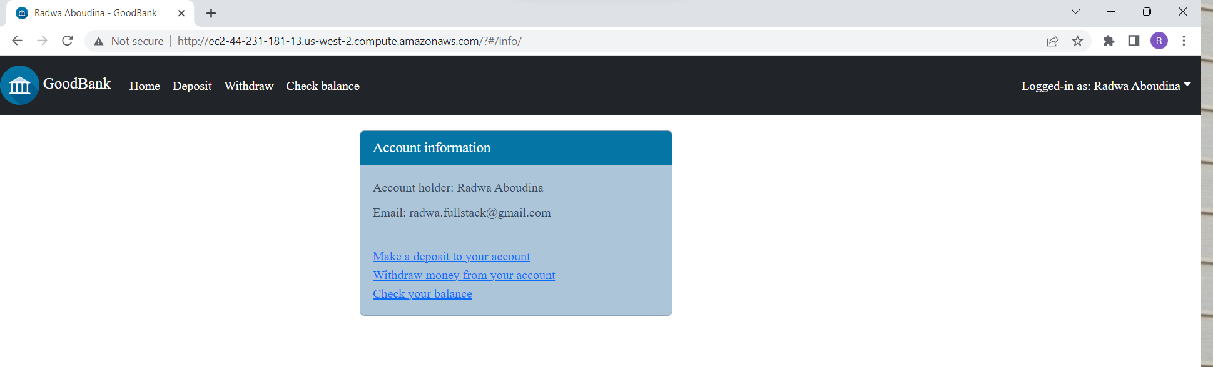
Additional Features
Users can see their account information.

Slide 31
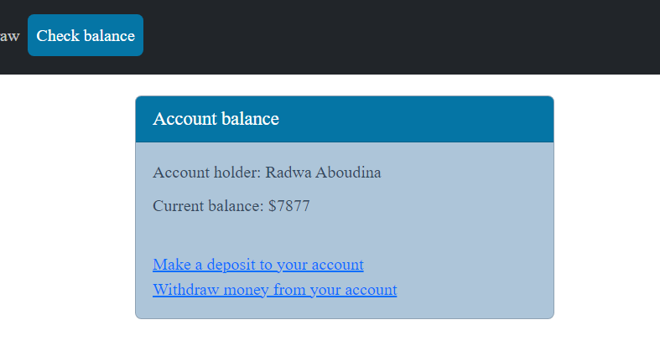
Additional Features
Users can see their account information.
Users can check their account balance, without needing to open the deposit or withdraw pages.

Slide 32
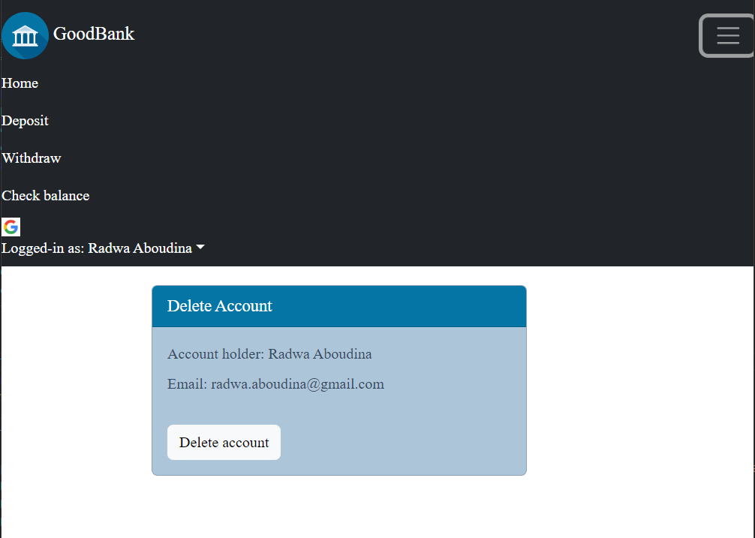
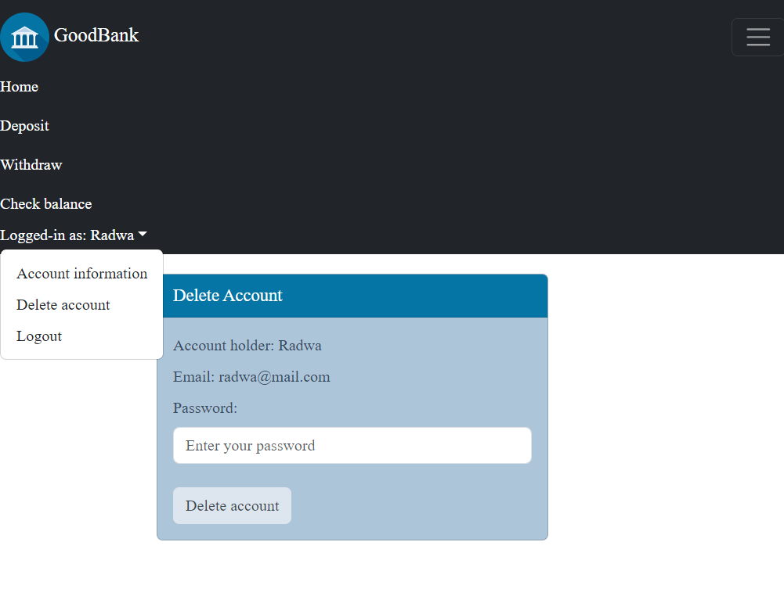
Additional Features
Users can see their account information.
Users can check their account balance.
Users can delete their accounts

Slide 33
Application Demonstration – Create Account, Log In, Deposit, Withdraw

Slide 34
Reflection
If I started the project today…
how would I structure my code differently?
I would separate the code that implements the different actions of every page in a different file from the one that has the react component.
I would make some functions in a single script file and share them between the deposit and withdraw actions pages instead of having redundancies.
I would perform the password encryption on the client side and send the password encrypted in the http requests to the sever.
What additional features would I add?
I would add different user role for admins, and give them some functionalities that need authorization like being able to view all the bank users, add new ones, change their balances, reset their passwords upon request or delete users.

